Slide 1


Introduction to Data Visualization

Slide 2
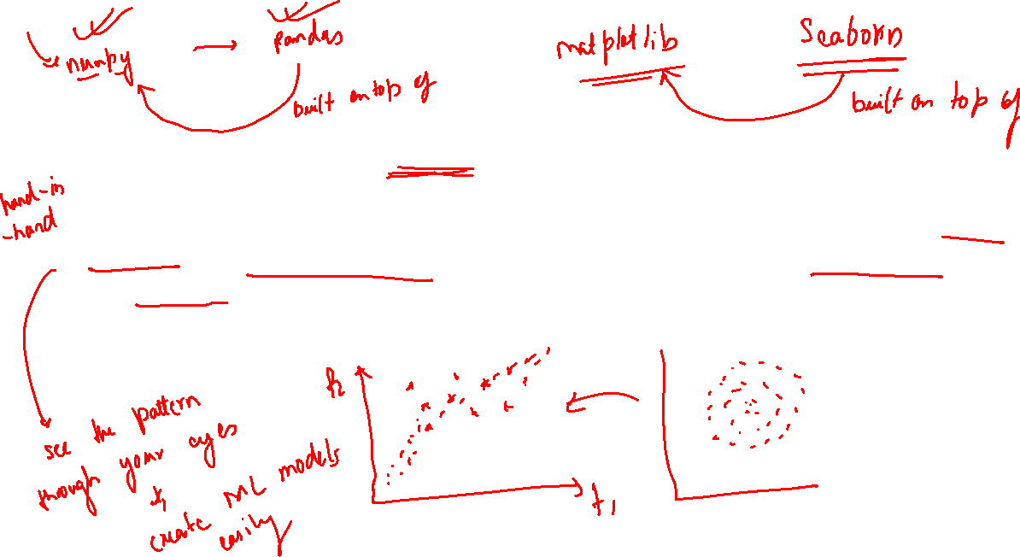
Data visualization is the graphic representation of data. It involves producing images that communicate relationships among the represented data to viewers. Visualizing data is an essential part of data analysis and machine learning. We'll use Python libraries Matplotlib and Seaborn to learn and apply some popular data visualization techniques. We'll use the words chart, plot, and graph interchangeably in this tutorial.

Slide 3
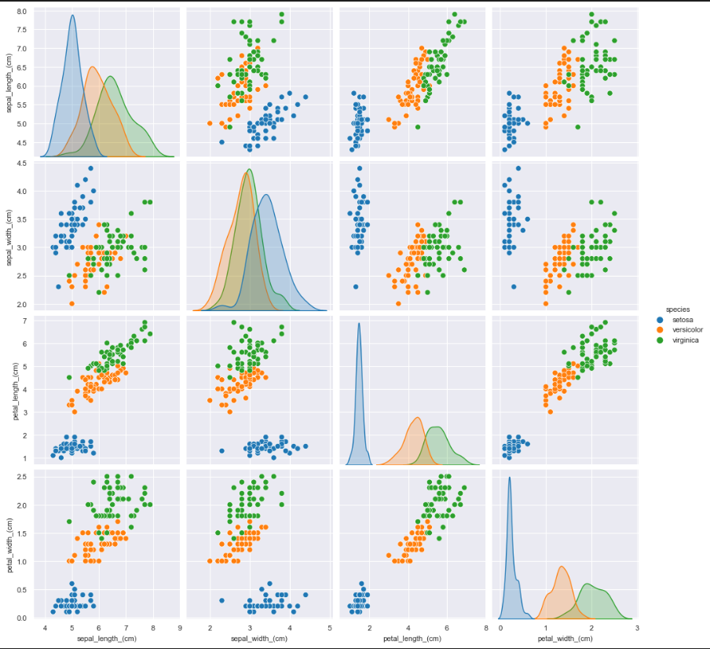


Slide 4
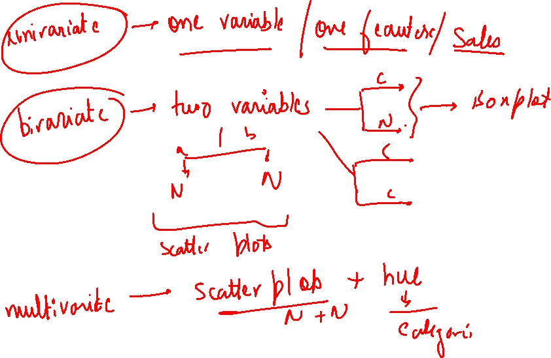

Slide 5
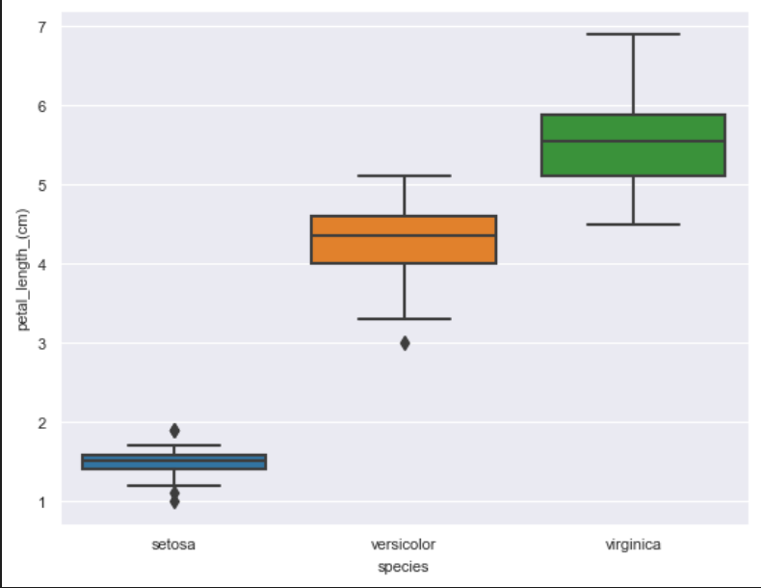
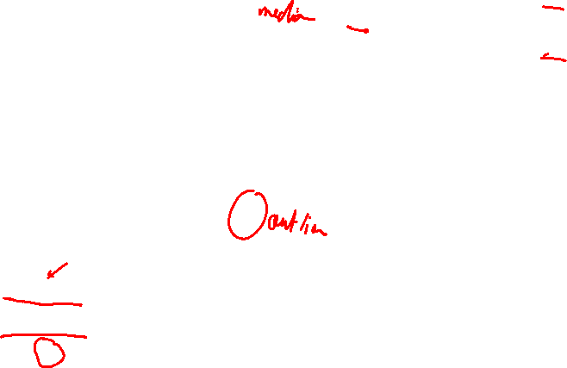

Slide 6
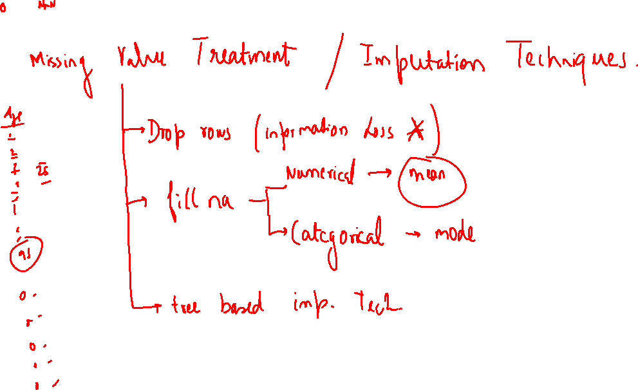


Slide 7
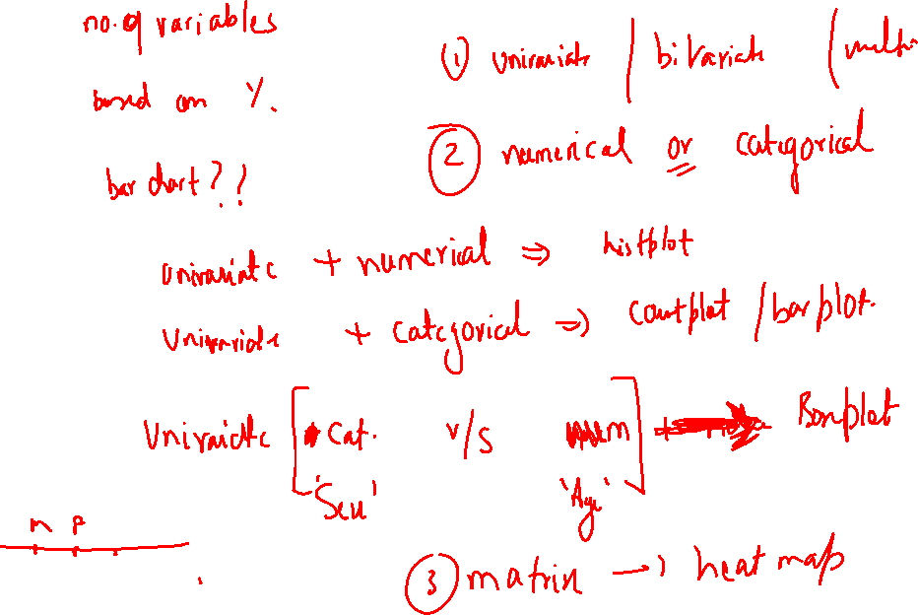

Slide 8
PassengerId 0.000000
Survived 0.000000
Pclass 0.000000
Name 0.000000
Sex 0.000000
Age 19.865320
SibSp 0.000000
Parch 0.000000
Ticket 0.000000
Fare 0.000000
Cabin 77.104377
Embarked 0.224467

Slide 9
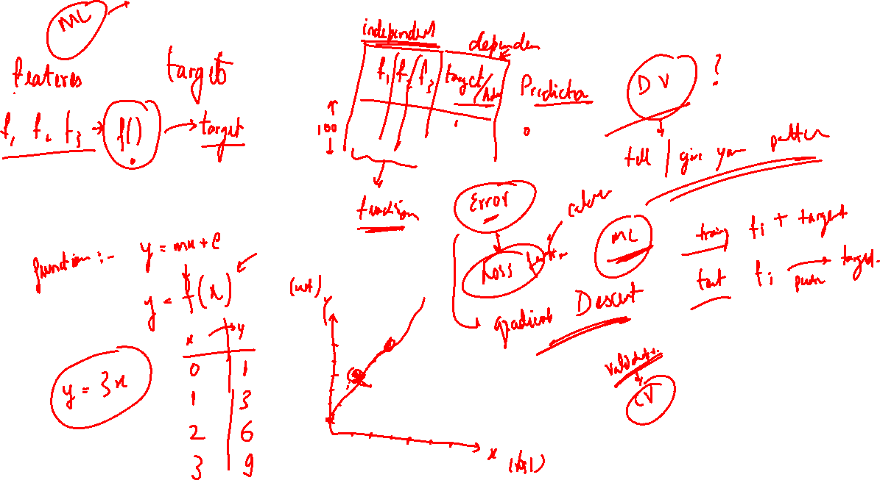

Slide 10
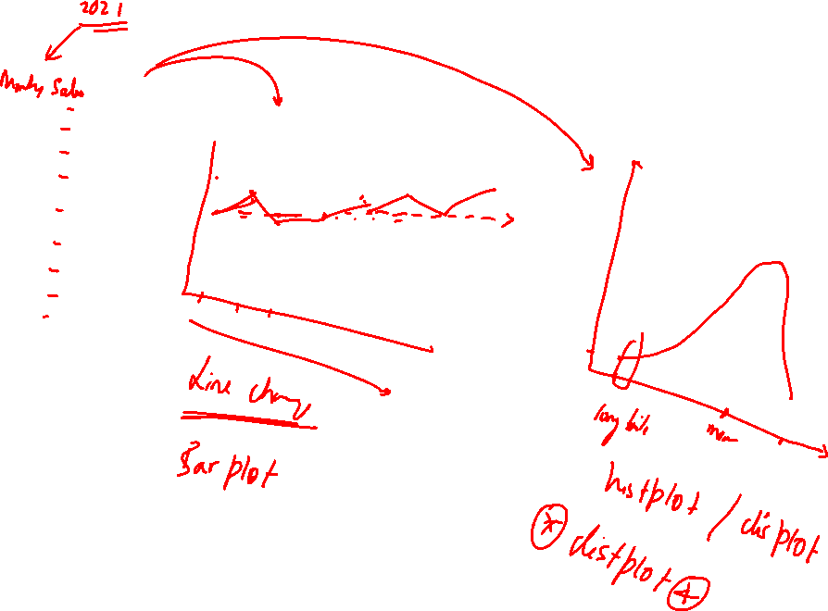

Slide 11
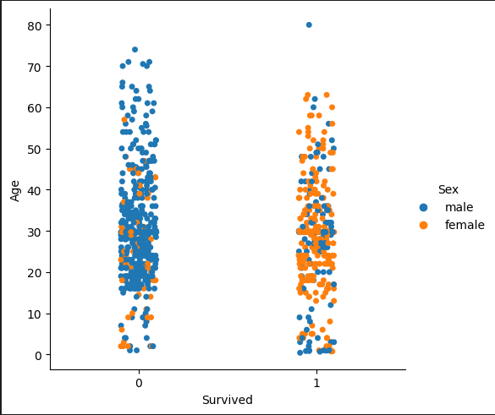
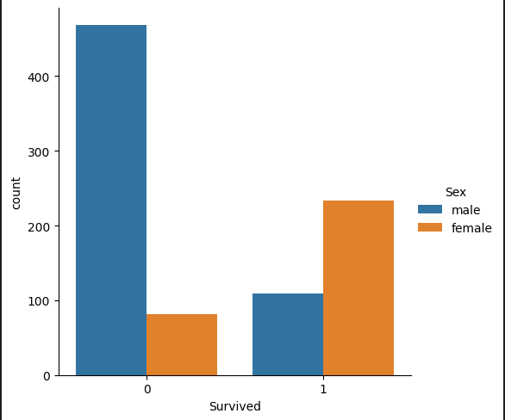


Slide 12
